Slide 1

RNS Institute of Technology
(AICTE Approved, VTU Affiliated and NAAC ‘A’ Accredited)
Department of Information Science and Engineering
(Accredited by NBA for the Academic Years 2018-19, 2019-20 and 2020-21)
Data structures Laboratory-18CSL38
Voting System Using Linked List
Staff in Charge: Mrs. Vinutha Lavanya
Designation: Assistant Professor
Carried out by:
Nidish G (1RN19IS94)
Phanish SN (1RN19IS100)
Hemanth Kumar M (1RN19IS063)

Slide 2
CONTENTS
Abstract ( slide 3 )
Introduction ( slide 4 )
Objective of the project ( slide 5 )
Data Structure ( Single Linked List ( slide 6))
System requirements ( slide 7)
Project Architecture
(Flowchart / Block Diagram / DFDs representing overall working of project with explanation: 2 slides)
Implementation modules ( slide 10 to 19)
( All functions prototypes (declarations) of the implemented code and explanations on how the function works)
Results ( slide 20 to 25 )
( Snapshots showing all the steps by steps results )
Conclusion & Future Enhancements - slide 26
References ( Web-links )-slide 27

Slide 3
Abstract
It represents simulation of real time voting with multiple contestants and analyzing their results in different aspects.
Our project uses basic functions to simulate real life voting system by calculating voter stats (randomly generated profiles),stats of the contestants and declaring the winner based on those calculated stats by considering appropriate conditions.

Slide 4
Introduction
Our project gives user a real time feel of the voting system.
It allows user to choose between multiple contestants and vote according to their desired choice .
It allows election commission(here the programmer) to check the results and declare the winner .
It allows the programmer to generate numerous random multiple votes to simulate a large scale voting system without manual user input easily and effectively.
User(Voter) can also enter manual inputs(Votes) .

Slide 5
Objective of the project
The main objective of our project is to show how electoral voting system works in real life.
The main specifications of our project are:
To generate random ‘N’ voters
To count the votes
To calculate the stats based on no. of votes
To declare the winner based on calculated stats

Slide 6

Data Structure
The Data Structure used in this project is Single Linked List(SLL).

Slide 7
System Requirements
This project was developed on an online compiler(repl.it).
It requires a basic computer with an active internet connection.
It requires all the basic C libraries.
Visit our project at :
https://repl.it/@NidPlays/DSA-Project-Work#main.c

Slide 8
System Requirements
PC Specs
Processor: Intel atom or higher
Online Internet connection
Ram: 4GB
Os: windows,linux,macos
Online compiler: https://repl.it

Slide 9
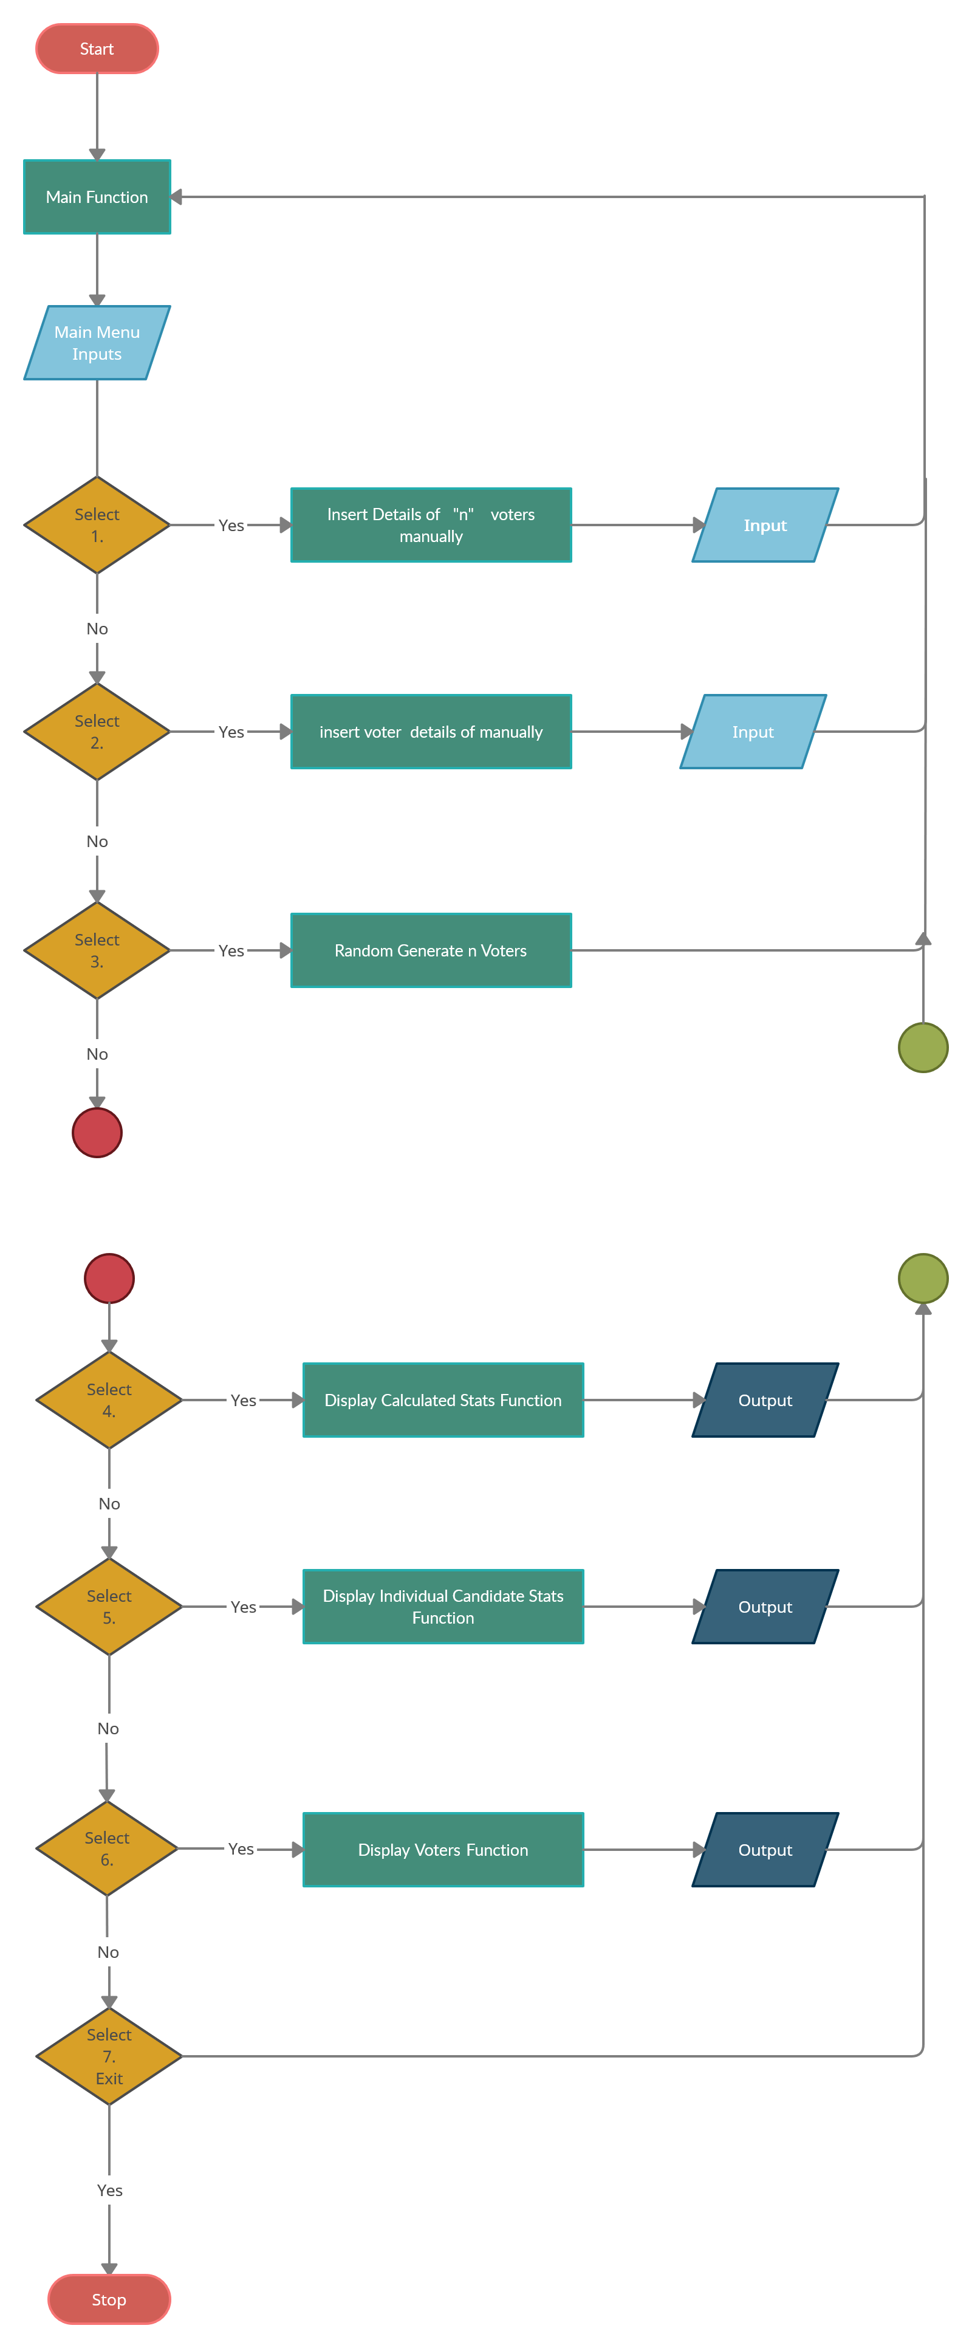
Project Architecture
The following flowchart shows step by step procedure of how our project works:

Slide 10
Project Architecture

Slide 11
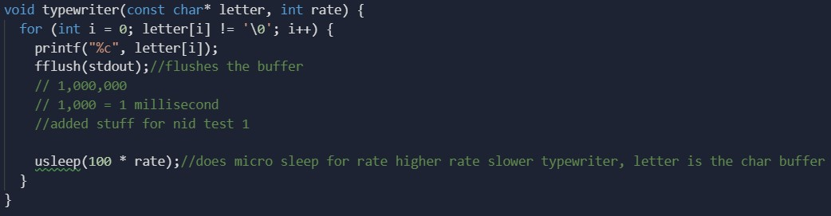
Implementation modules
This function(Typewriter) simulates the typing experience of typewriter.
In the above function, 'usleep' stops the execution of the program for the given time(micro seconds).

Slide 12
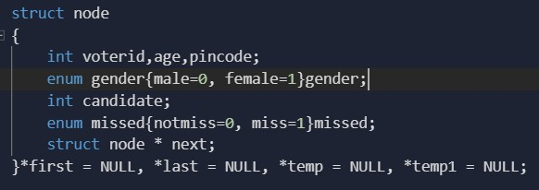
Implementation modules
This is the main structure which
is used to store data

Slide 13
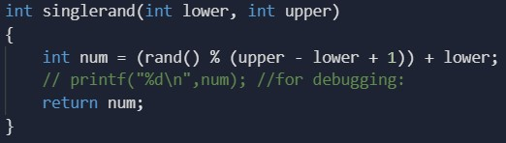
Implementation modules
This function is used to generate random inputs in the program.
The function randomly generates the inputs between the upper and the lower limits(range).

Slide 14
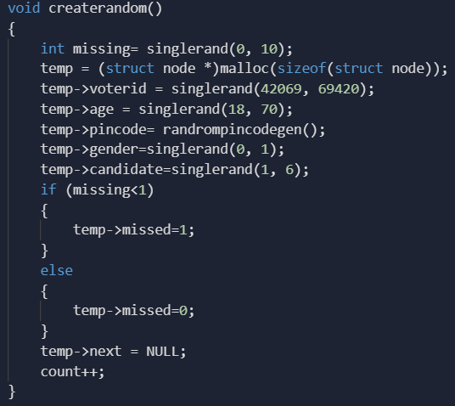
Implementation modules
This function is used when we insert new voters using random generation​

Slide 15
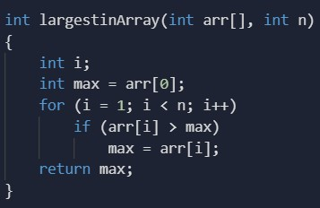
Implementation modules
This function is used to find the largest element in an array

Slide 16
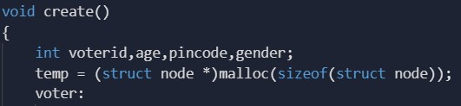
Implementation modules
This function is used when we insert voter details manually and we need to choose the candidate

Slide 17
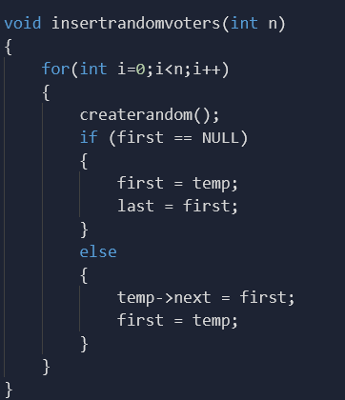
Implementation modules
This function is used to insert random voters into the linked list

Slide 18
Implementation modules
This function counts the number of voters, missed voters and nota and displays who won the election and candidate specific statistics

Slide 19
Implementation modules
This function is used to calculate statistics based on the various parameters that is given in the struct, i.e. voters in specific age group, gender of voters, total number of voters, nota voters and missed voters

Slide 20

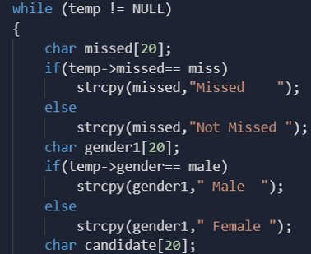
Implementation modules
This function is the display function which displays all the candidates at once

Slide 21
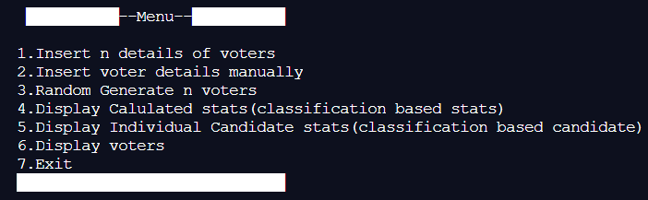
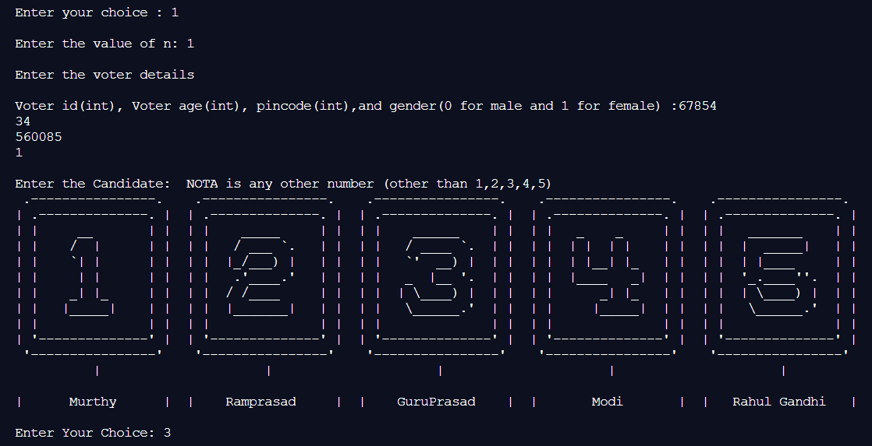
Results
Output when the first(1.) option is selected

Slide 22
Results
Output when the second(2.) option is selected.
It will be same as the first option but we will be allowed to insert the details of only one voter.

Slide 23

Results
Output when the third(3.) option is selected.
Here 20 random voters will be generated.

Slide 24
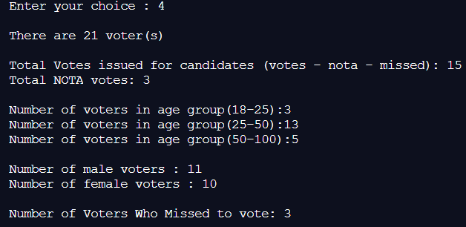
Results
Output when the fourth(4.) option is selected.

Slide 25
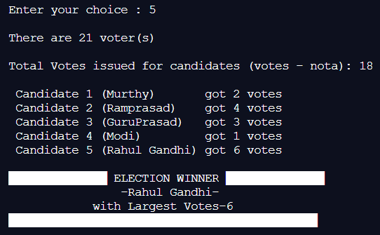
Results
Output when the fifth(5.) option is selected.
The stats and the winning candidate will be displayed.

Slide 26
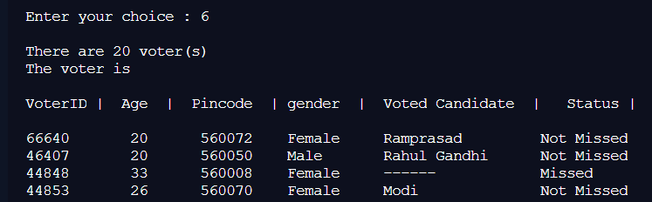
Results
Output when the sixth(6.) option is selected.
The details of the randomly generated voters will be displayed(Here 20 voters were generated).

Slide 27
Conclusion & Future Enhancements
In our upcoming days, as we learn more about data structures, we plan to implement them and enhance this project further more.
We are also open to any type of suggestions/advises .
Permanent data storage and also add more limits to data inputs.
Adding a web interface for ease of use
We have already done some implementations the teachers have suggested us

Slide 28
Conclusion & Future Enhancements
The project also now has feature when two candidates have same number of votes and displays which two candidates have the collision.

Slide 29
References
This project was built from scratch by us.
We referred Narasimha Karumanchi's Data Structures and algorithms made easy textbook for extra knowledge on SLL.
Visit our project in the given link:
https://repl.it/@NidPlays/DSA-Project-Work#main.c​

Slide 30
THANK YOU

